Slide 1
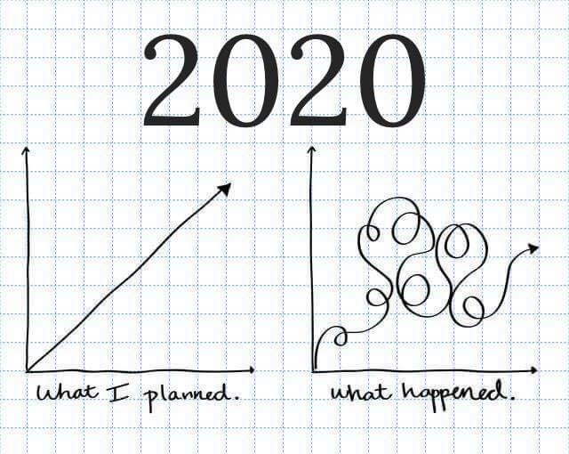
Self-Care and COVID-19: How are we “really” doing?
Lauren Thorn, MSW, LCSW
Associate Dean of Students
East Carolina University

Slide 2
The Story of this Presentation

Slide 3
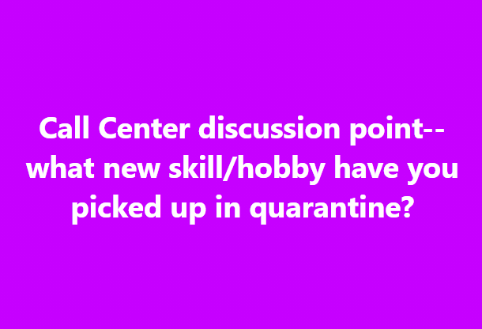
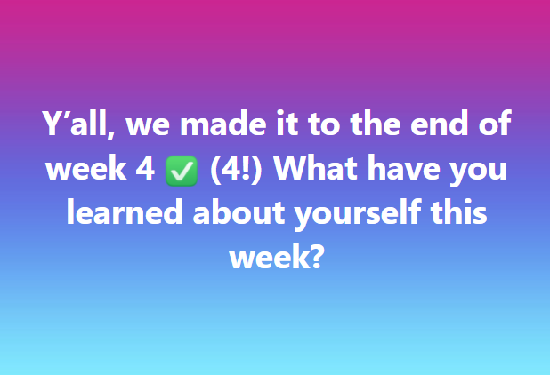
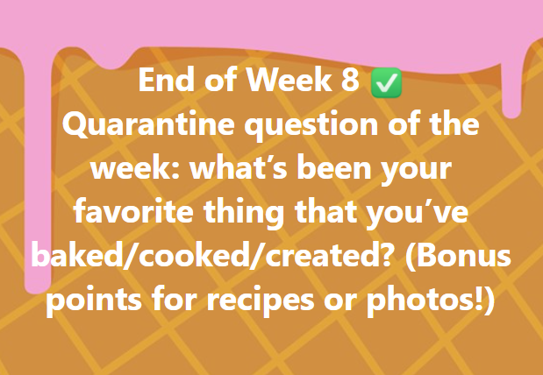
“Quarantine Question” Fridays

Slide 4
What has COVID-19 taught you about self-care?

Slide 5
Stress and self-care and crisis management and surge capacity…
“Surge capacity is a collection of adaptive systems — mental and physical — that humans draw on for short-term survival in acutely stressful situations, such as natural disasters. But natural disasters occur over a short period, even if recovery is long. Pandemics are different — the disaster itself stretches out indefinitely.”
- Tara Haelle

Slide 6
Time to check in…

Slide 7
Signs of burning out

Slide 8
Where do you fall?

Slide 9
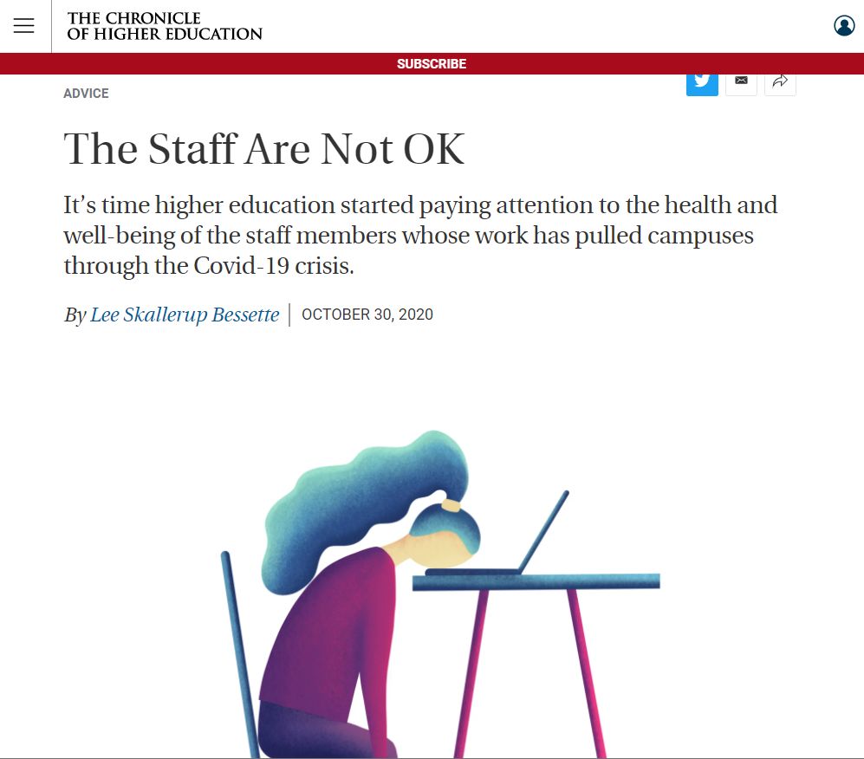
Pandemic fatigue and burnout
Most of us just spent our summers working overtime to ensure that the campus was ready — in whatever format that entailed — for the fall.
Many staff members were required to put their health and safety on the line to be on the campus, while others had to fight for the right to work remotely. Hiring freezes have meant more work with fewer people. Wage freezes and furloughs have stretched us to our limits.
In short: The staff are not OK.

Slide 10
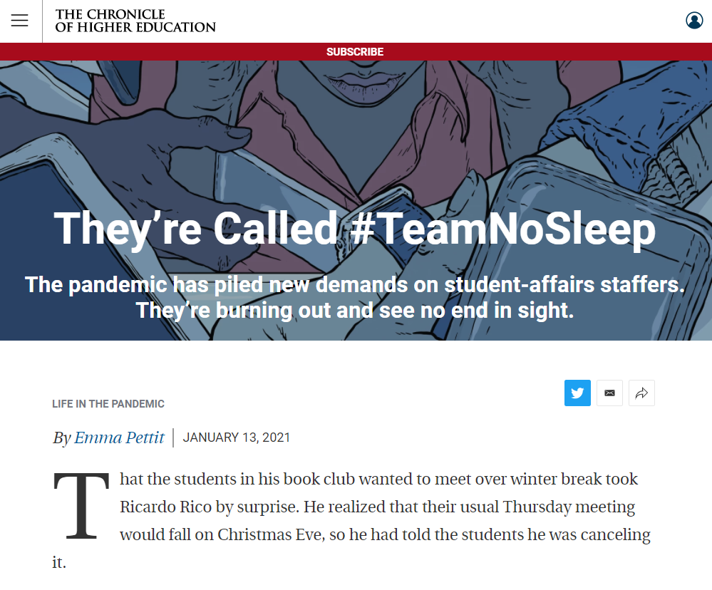
Pandemic fatigue and burnout
By nature, student-affairs professionals deal in crisis, said Martha Compton, president of the Association for Student Conduct Administration.
But “nobody’s meant to deal with a crisis for 10 months straight.”
#TeamNoSleep

Slide 11
Pandemic fatigue and burnout
She knew the pace was unsustainable. Legions of professors are hitting the wall in their own ways. For some, like Rutuku, the problem has been a crushing workload combined with child-care challenges.
For others, it’s a feeling that their institution expects them to be counselors and ed-tech experts on top of their regular responsibilities, even if it means working seven days a week.
Black and Latino professors are bearing additional burdens, supporting students of color and contributing to the national debate on racism.

Slide 12
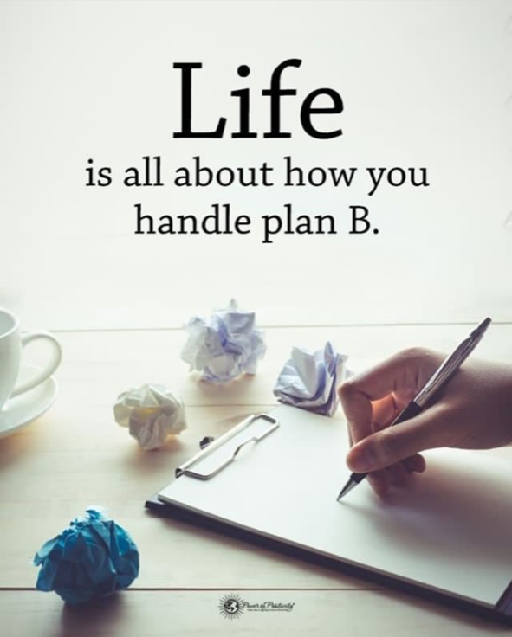
Decision fatigue
But the pandemic has increased decisions, too, or made what used to be easy choices more difficult. “People working and schooling from home have had to figure out where everyone is going to do their work, what times are best and worst for focused work, when to take breaks, and how to eat lunch without disrupting others,” Dr. Vohs says.
“The lack of a routine in such a big part of our lives—the period from 8am to 4pm—has created a whole host of new decisions.”

Slide 13
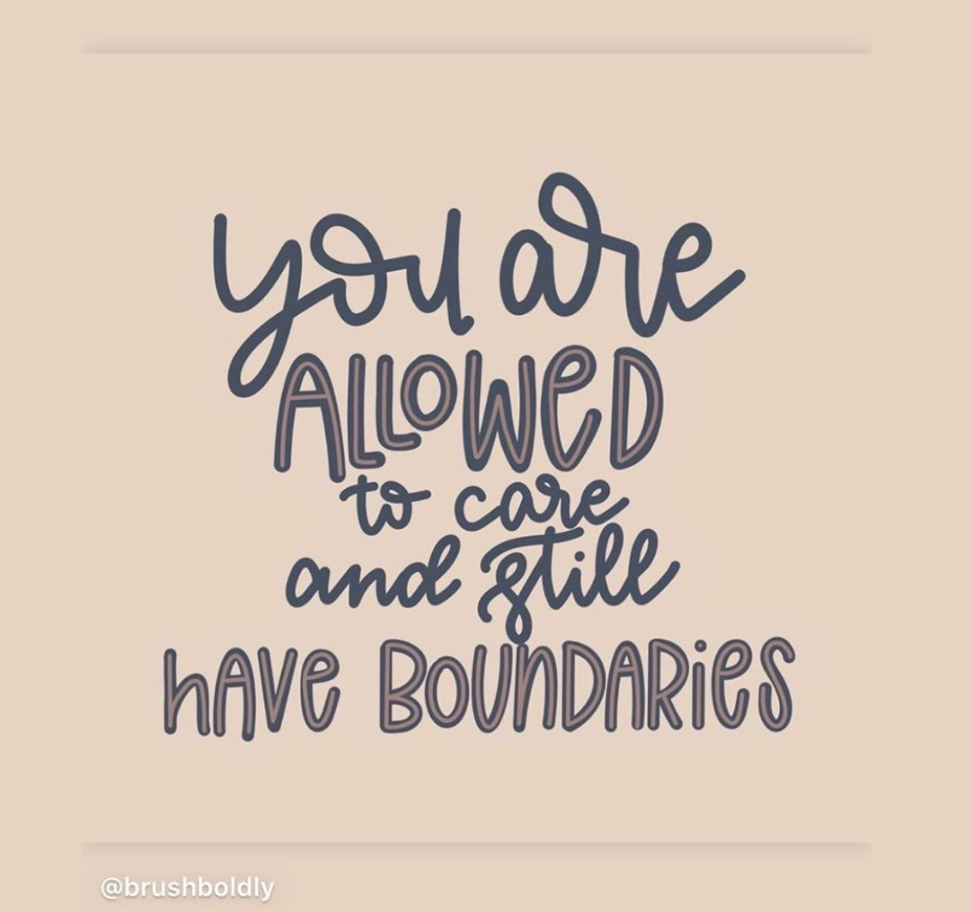
Lack of structure, routine & boundaries
When home becomes work, work more easily overtakes home…

Slide 14
Ambiguous loss
“We’re simultaneously joining virtual meetings, consuming the news, educating children, and checking on loved ones. The boundaries between what we know and what we don’t know about what is safe and what is science have become complicated.
While we’re trying to find ways to soothe ourselves and each other, we’re canceling birthdays, vacations, and weddings. We’re also losing scheduled surgeries, new jobs, the ability to pay rent, and, overall, the feeling that we can predict what will come next and that we are in control.
This type of loss, which can’t be concretely verified or easily resolved, is called “ambiguous loss" and is a term developed by Dr. Pauline Boss. Boss developed the idea of ambiguous loss to help explain the reactions people feel when experiencing grief that is marked by the inability to confirm a person’s whereabouts, their death, or their ability to come back and return to “normal.”

Slide 15
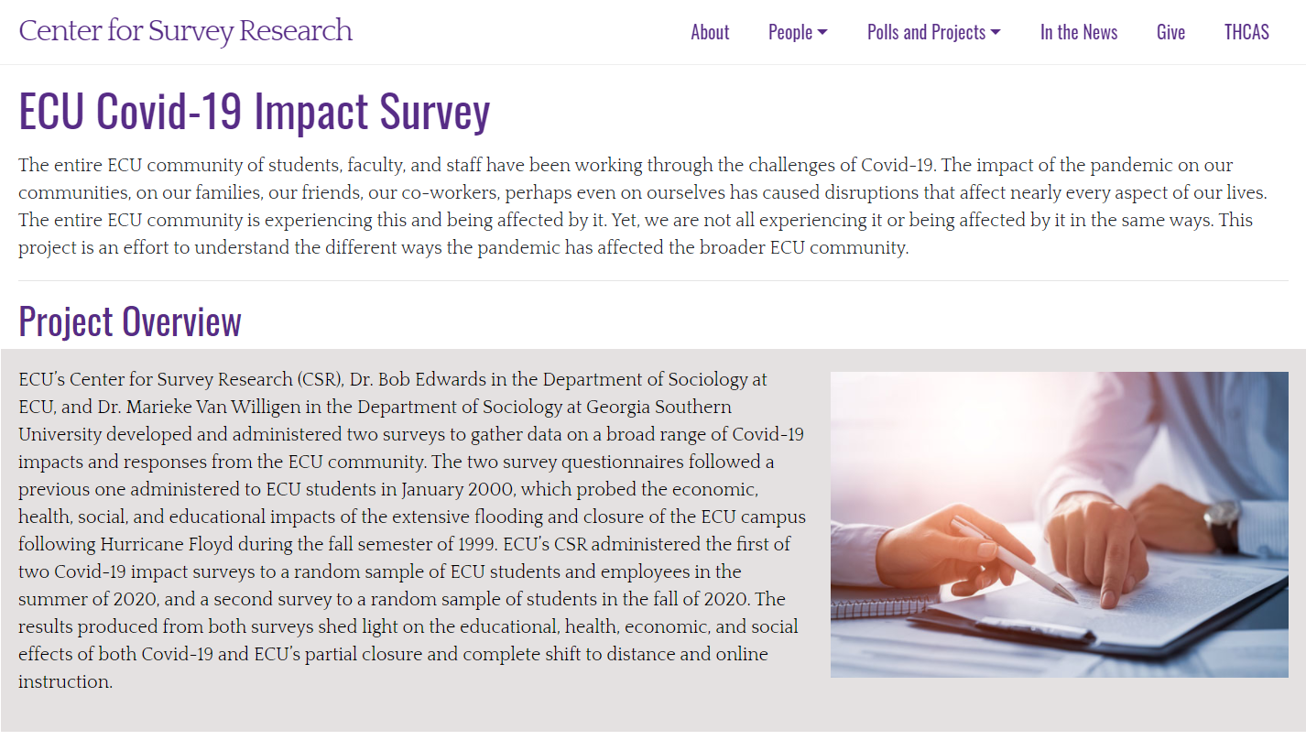
ECU COVID-19 Impact Survey
36.9% of staff reported increased work commitments.
49.6% of staff reported increased family responsibilities.
Female respondents were more likely to report having increased work and family responsibilities. Approximately 42.9% of female respondents reported increased work responsibilities compared to 22.7% of male counterparts. The same can be said for family responsibilities with 57.1% of female staff members reporting increased responsibilities compared to 31.8% of male respondents.
Staff members’ well-being and stress levels were seemingly affected by the pandemic. Some 31.5% of staff reported feeling a “great deal” more anxious, while 23.4% reported feeling a “great deal” more irritated, and 22% reported having more difficulty concentrating.

Slide 16
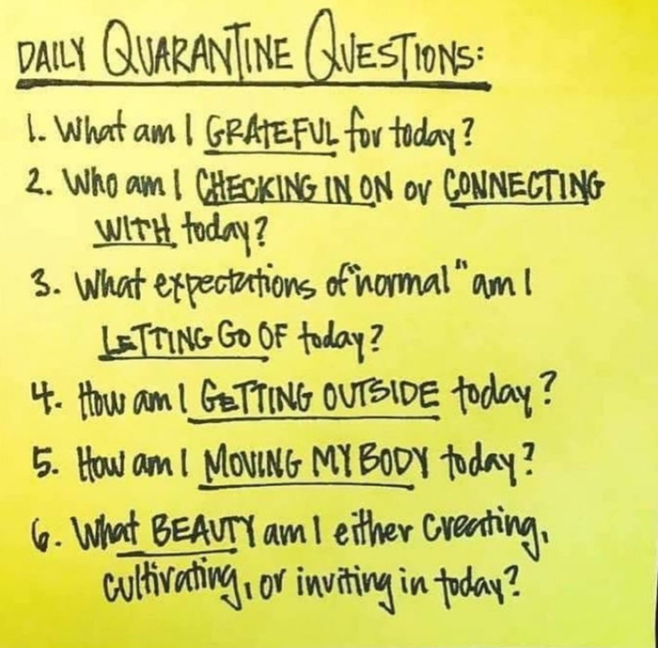
Acknowledging that our experiences will vary….

Slide 17
And that no one has all the answers, but we do know this:
Something’s gotta give.

Slide 18
The internalized stress and burnout from COVID-19 has the potential to negatively impact generations.

Slide 19
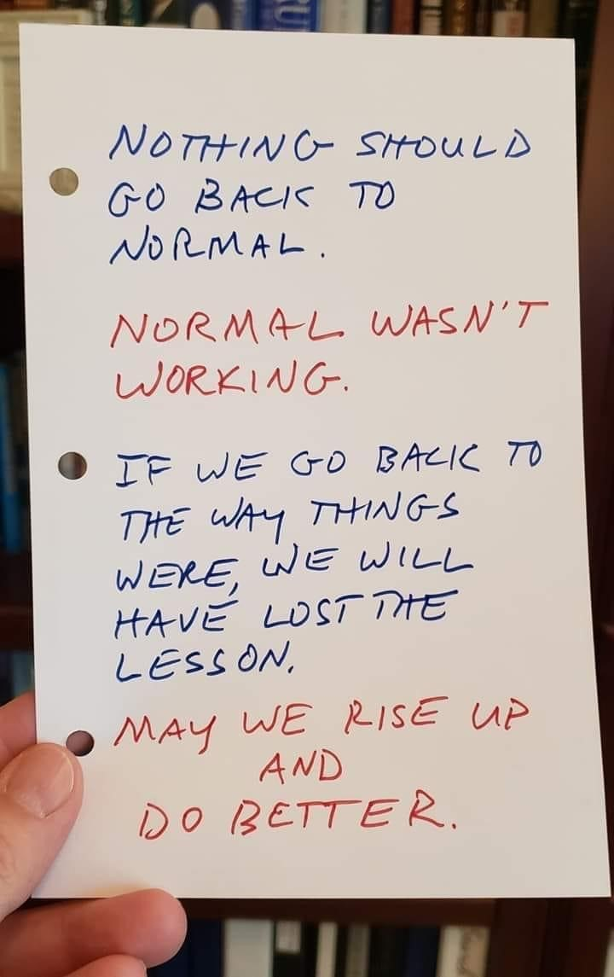
It’s time to pause and re-evaluate.
As individuals.
As organizations.
As a culture.
And as a profession.

Slide 20
Take a moment and consider…
What has COVID-19 caused you to change (for the better?)
What patterns or routines have you created that you would like to maintain?
What parts of your “pre-pandemic” life would you like to leave in the past?

Slide 21
Thinking about who we choose to be…

Slide 22
Thinking about what we can control…

Slide 23
And finding ways to incorporate self-care in meaningful, intentional steps that work for you as an individual

Slide 24
So… what is self-care?
The practice of taking action to preserve or improve one’s own health
Any activity we do deliberately in order to take care of our mental, emotional, and physical health

Slide 25
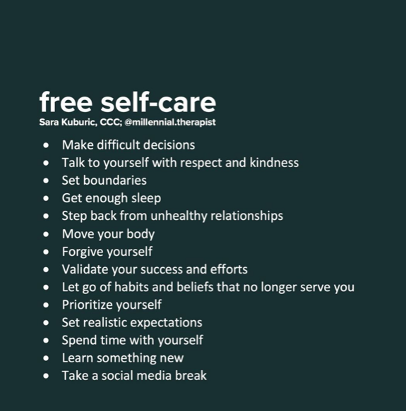
What is self-care NOT?
Self-care is NOT expensive “once in a while” activities, like a spa day or big golf weekend or family vacation.
Self-care is NOT running errands. (Just because you lie down and sit still to get your teeth cleaned doesn’t mean it counts.)
Self-care is NOT SELFISH. So stop the guilty feelings and just do it!
Self-care is NOT just activity oriented. It can also include shifting your thoughts/perspective and changing personal outlook.

Slide 26
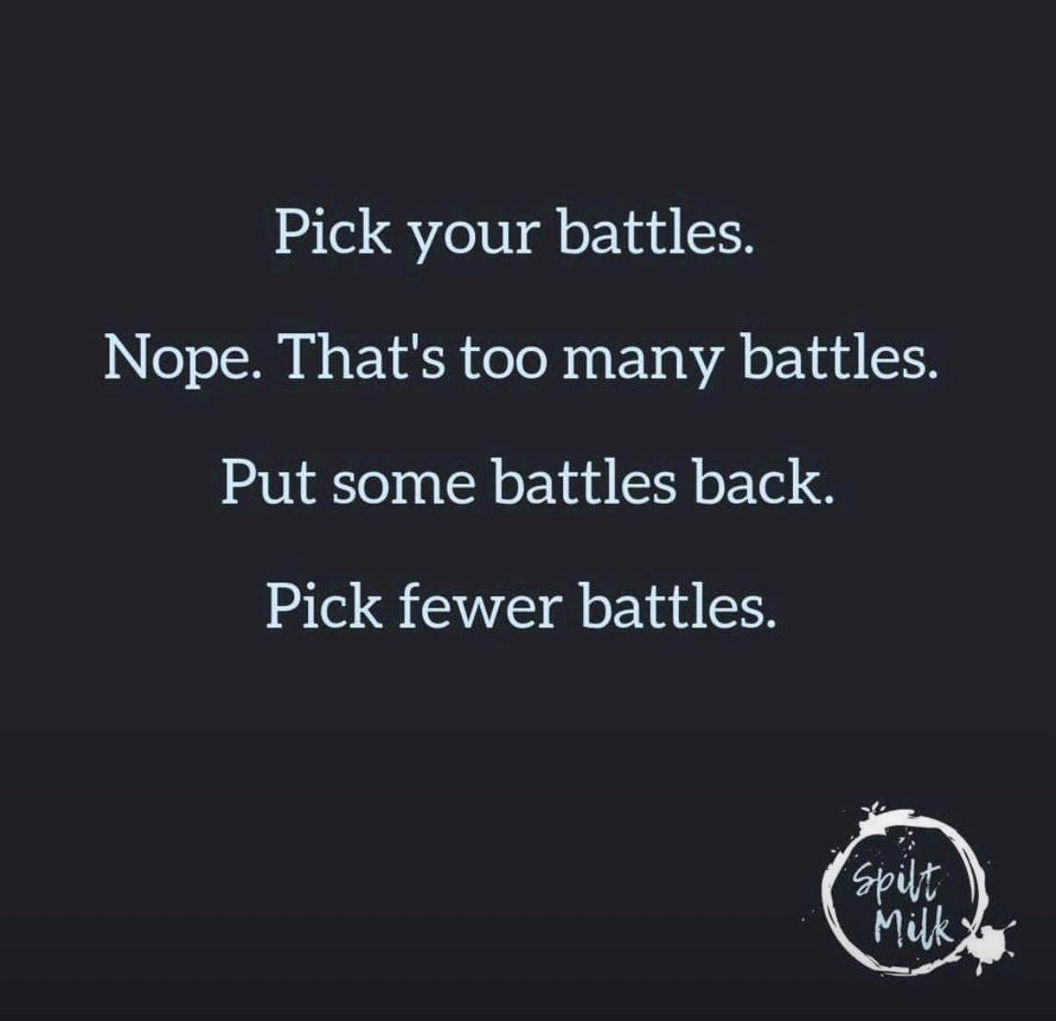
So what did the Facebook collective say about self-care?

Slide 27
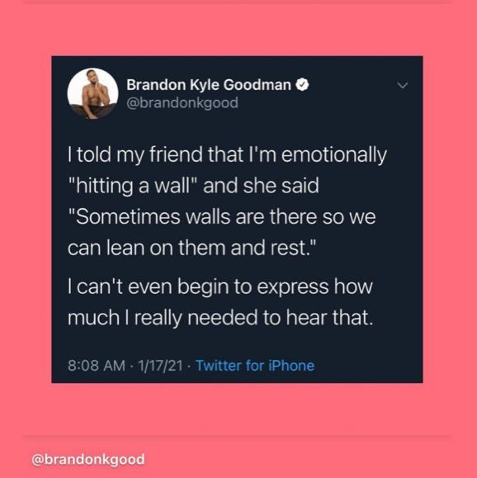
COVID-19 and Self-Care
That it’s not one size fits all - what relaxes one may stress another to no end. You may have to Marie Kondo a few ideas, things, etc. but eventually you’ll figure out what’s right for you.
Self care isn’t just about me, if I do my part for myself, others will benefit, too.
I realized my mental health relies heavily on human interaction.
I’ve learned that it’s okay to not be working every moment of the day. To take a break and enjoy a moment.

Slide 28
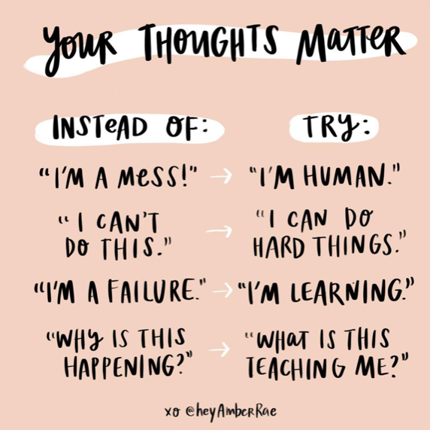
COVID-19 and Self-Care
During this time, I’ve learned indulging in self care is hard for me if I know others are working hard or drowning in work. Because of that I found myself overworking to take the load off others... only to find, I was doing more harm to myself. I was not able to be a true help to anyone. It took all semester for me to figure out, I have to take more time for myself even if others are still working. That’s the only way I can stay healthy both mentally and physically. I can’t say I’m there yet, but I’ve recognized this... so it’s a work in progress:
Offering grace to myself and others around me. I’ve had to take a step back and realize that the standards I hold myself to, it isn’t fair to enforce those on others. Doing that has cut down on my stress level.

Slide 29
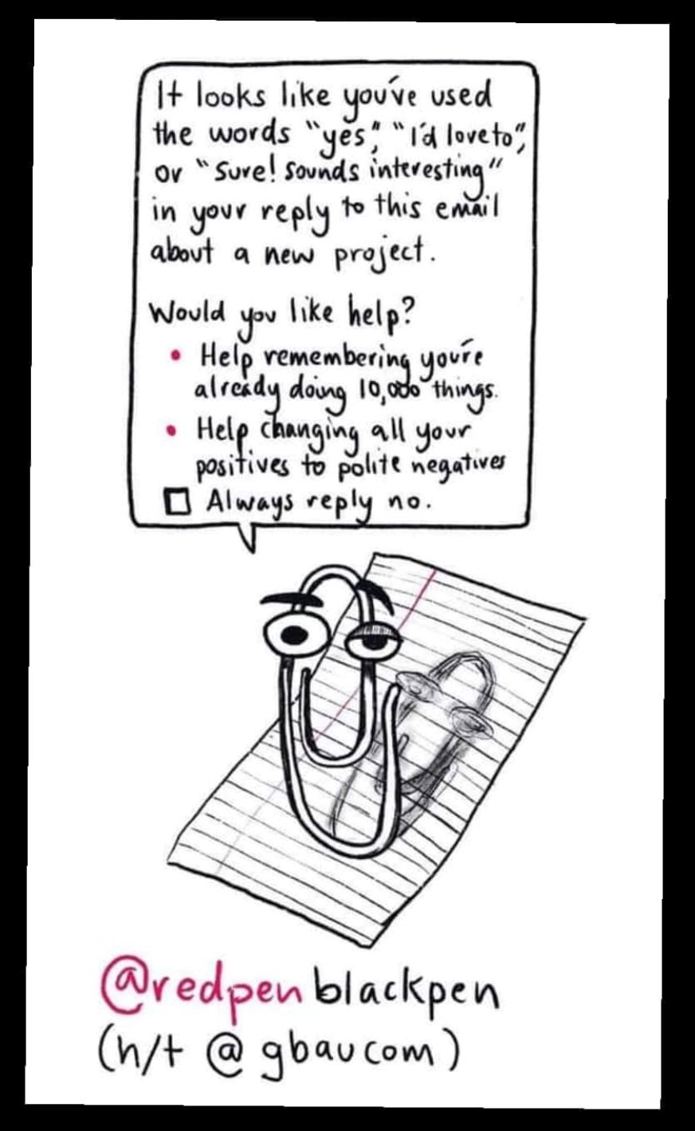
COVID-19 and Self-Care
To actually do it. I feel like I thought I was indestructible but working remotely, looking at a screen 8-12 hours a day, having limited isolation, and the world being a mess it was a lot and it took a toll on me. Allowing myself to check out for even just an hour at a time, taking PTO, making sure I eat, and reminding myself that I don’t have to do everything myself made a huge difference.
I always need a project. Personal or work- my mind goes to worst case scenarios without some busy work / projects.

Slide 30
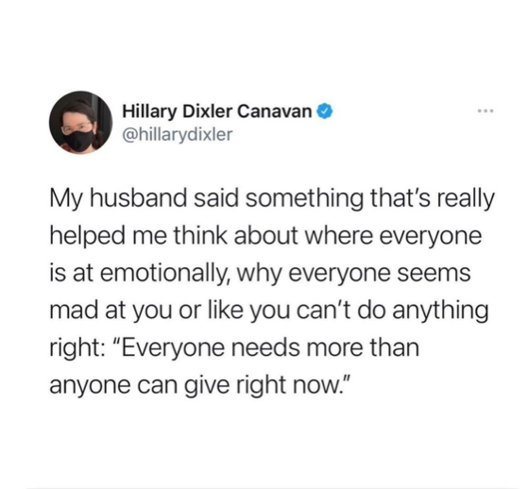
COVID-19 and Self-Care
Self-care for me means a lot of positive self talk, healthy eating, physical activity, and finding something that makes me grateful and happy every single day. I no longer have a problem saying no to anyone if it means I will be able to take care of myself and be more helpful later. I am honestly happier than I have ever been. This pandemic has obviously been a good thing for me in that respect.
I’ve learned to take care of myself with all of the love languages and it has transformed my life!

Slide 31
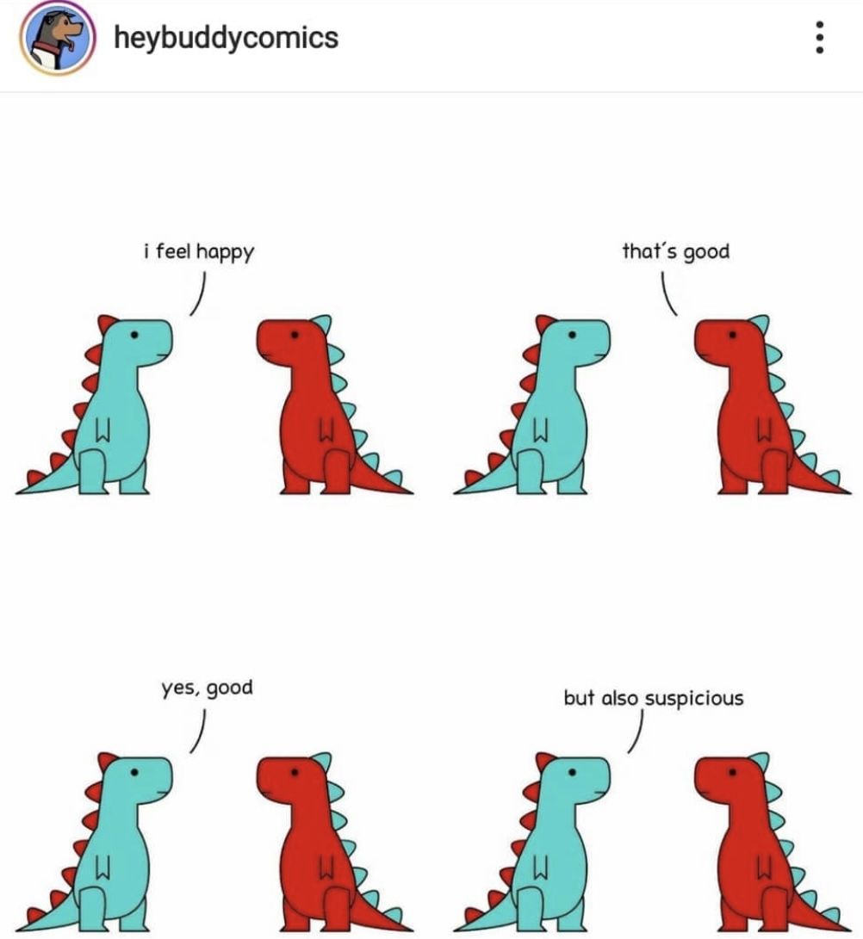
COVID-19 and Self-Care
That I don’t require external validation as much as I thought I did. I went through social WITHDRAWAL (no exaggeration; there was sweat and bargaining and depression and lost sleep), and eventually a level of growth, learning to fulfill my sense of self internally, and not grounded in others.
It’s taught me how much I rely on human touch and interaction. I’m a natural born hugger and not being able to hug people ( former students, parents, co-workers) when I run into them has caused some depression. I also didn’t know until all this, how much I enjoy seeing people smile.
There's no one right way to do self care. It's important to remember that it's for you to empower you. Setting the intention of taking time for yourself is rewarding, relaxing, and energizing.

Slide 32
Take a minute to check in
What ideas or concepts jumped out at you?
What feels realistic?
How can you take some of these concepts back to your individual office/department or family unit?
How can you promote the concept of self-care to the larger systems?

Slide 33
Resources
“Stress is not bad for you; being stuck is bad for you.”

Slide 34
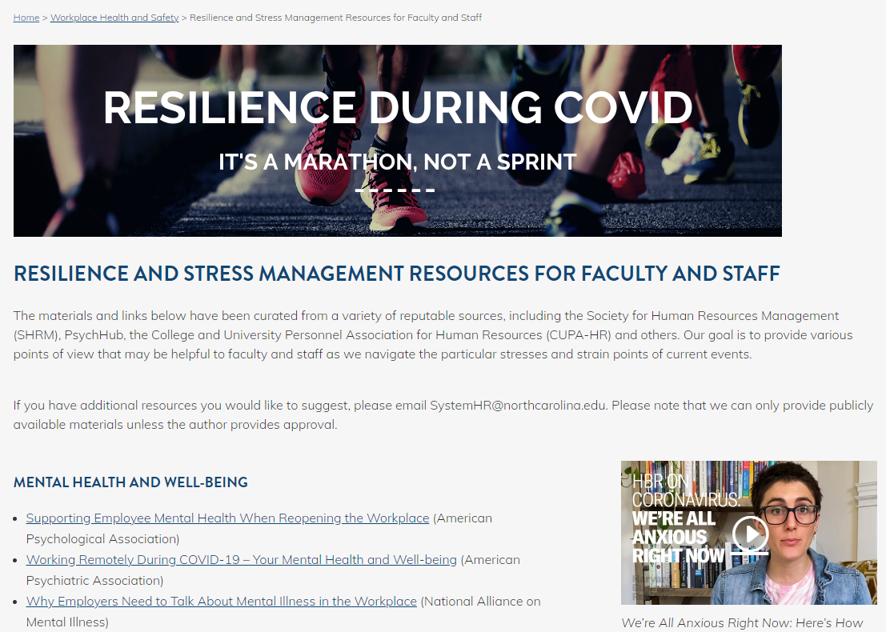
UNC System Office Resilience Website
Series of web-based resources related to:
Mental health and well-being
Resilience and equity
Stress Management
https://myapps.northcarolina.edu/hr/health-safety/fac-staff-resilience/

Slide 35
Faculty & Staff Assistance Program
ComPsych
Available 24 hours a day, 7 days a week
Call: 833.743.8183 TDD: 800.697.0353
Online: guidanceresources.com Web ID: ECUFASAP
Coronavirus Digital Toolkit
GuidanceResources US Coronavirus Resources (e2ma.net)

Slide 36
Employee Wellness Institute
The ECU Employee Wellness Institute (WI) provides participants with an opportunity to learn about personal and professional wellness.
Benefits:
improved health,
stress reduction techniques,
financial management,
exercise and fitness practice,
heightened personal performance,
reduced sick leave, reduced medical costs
stronger interpersonal relationships.
The Institute is open to all University Staff and Faculty.

Slide 37
Articles referenced
https://elemental.medium.com/your-surge-capacity-is-depleted-it-s-why-you-feel-awful-de285d542f4c
https://www.chronicle.com/article/the-staff-are-not-ok
https://www.chronicle.com/article/theyre-called-teamnosleep
https://www.chronicle.com/article/the-pandemic-is-dragging-on-professors-are-burning-out
https://www.health.com/mind-body/decision-fatigue
https://www.psychologytoday.com/us/blog/in-sickness-and-in-health/202005/covid-19-and-ambiguous-loss
https://surveyresearch.ecu.edu/wp-content/pv-uploads/sites/315/2018/06/Covid_Staff_Report.pdf

Slide 38
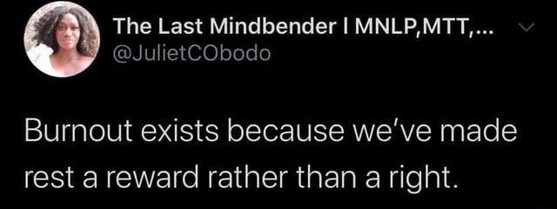
Final thoughts
Be prepared to change your self-care routine as your needs change.
Be your own best advocate.
Find those who can help support you in your self-care journey—and it is a journey, not a destination. You will never reach “peak self-care.”
Use your resources, set boundaries, and know when to seek out professional services.
Talk about it with others. Let’s normalize self-care!

Slide 39
Questions?
For follow up: thornla@ecu.edu

